Slide 1


Crises initiative
PDEng data science: https://www.jads.nl/pdeng-post-master-data-science.html
a.abbasi1@tue.nl
Notes:
heloo

Slide 2
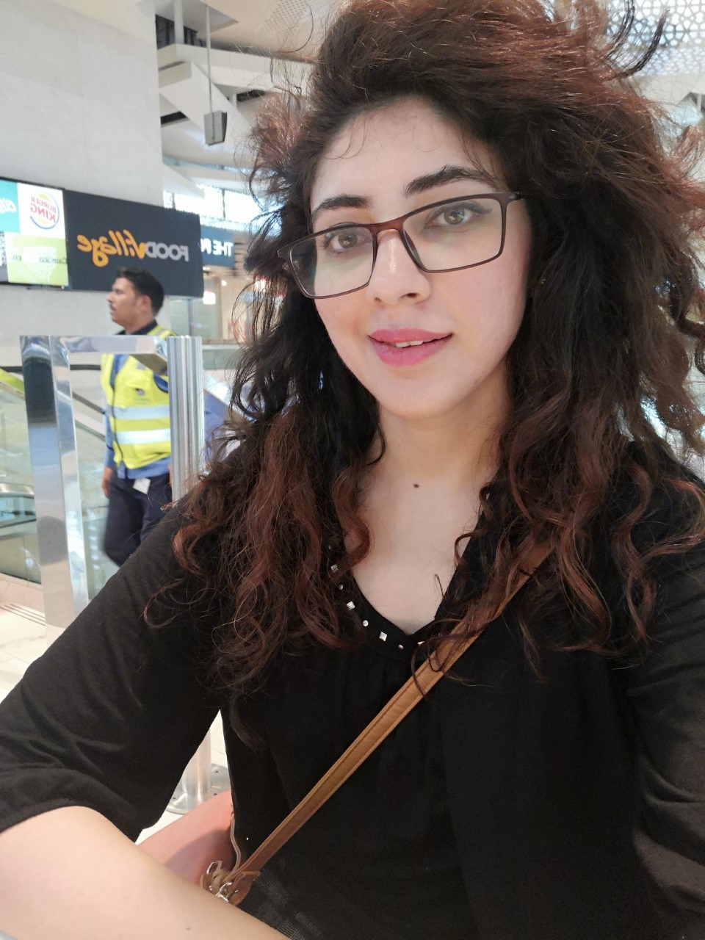
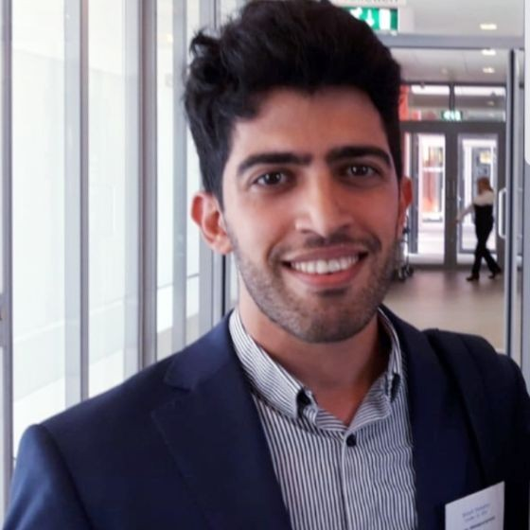
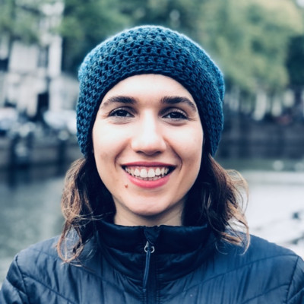
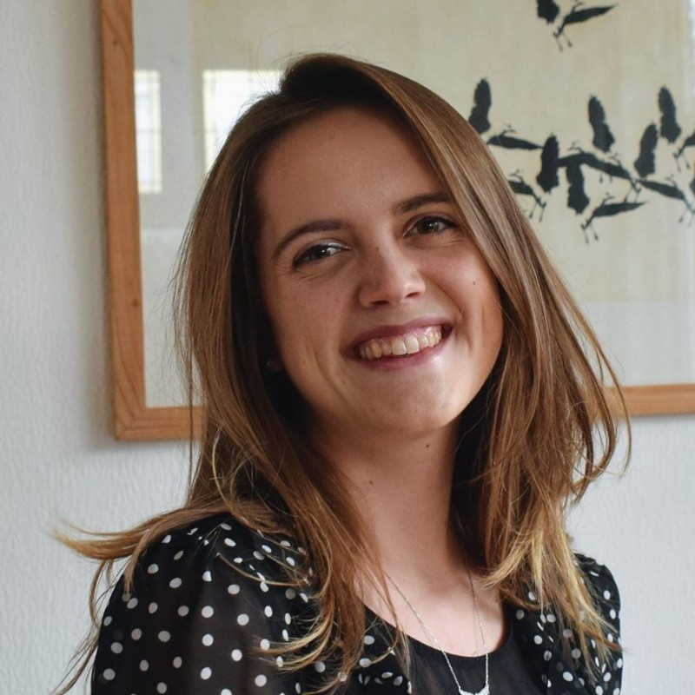
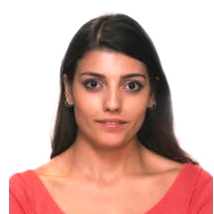

PDEng Team
Aneesa Abouzar Zeynab
Eelke Simay Angeliki
Notes:
My name is Aneesa, I am a PDEng –datascience trainee at Jads. Joined jaunary 2020. We are a group of six pdeng trainees or data scientists from different generations who decided to team up and partipated In the hackathon held on from 3-5April.

Slide 3


a.abbasi1@tue.nl
Notes:
Something about the hackathon.
Dutch hack the crsises was initiative taken by diiferent entities to bring out of box solutions for the ongoing crises situation.
52 teams. Four categories: Healthcare and well being , remote education, sme business continuity , logistics and supply chain.
How can the medical equipment manufacturers use the data regarding the number and distribution of patients in different countries in order to adapt their supply chains and transportation mechanisms?
We came up with the idea of SOTI, which in detail I’ll explain later. SOTI greek goddess of healing.
Medical equipment is key in dealing with the current situation. As there is a shortage of medical equipment, many manufacturers have dedicated production lines to produce these equipment. However, this does not guarantee that the shortage issue is fairly answered across the globe (we have all heard some not nice news about medical aid not arriving at their final destination…) The use of AI could aid in determining the future number of patients in different countries and predict the number of required medical equipment. This data can be used by manufacturers to have an idea on how many equipment is needed. Afterwards, through transportation, the medical equipment could be sent to the target countries.This solution could ensure that every human’s life is treated equally. In addition, it can reduce the tension and stress on medical staff and allow them to concentrate on treating patients. Finally, by bringing different industries together, new business opportunities could be created. The challenge is then how can such a solution be realized? For this challenge the following specialists are required: 1. Medical staff 2. AI 3. Mathematic 4. Logistics 5. Transportation 6. Product design

Slide 4
1. Question
How can the medical equipment manufacturers use the data regarding the number and distribution of patients in different countries in order to adapt their supply chains and government connect to them in time?
a.abbasi1@tue.nl

Slide 5



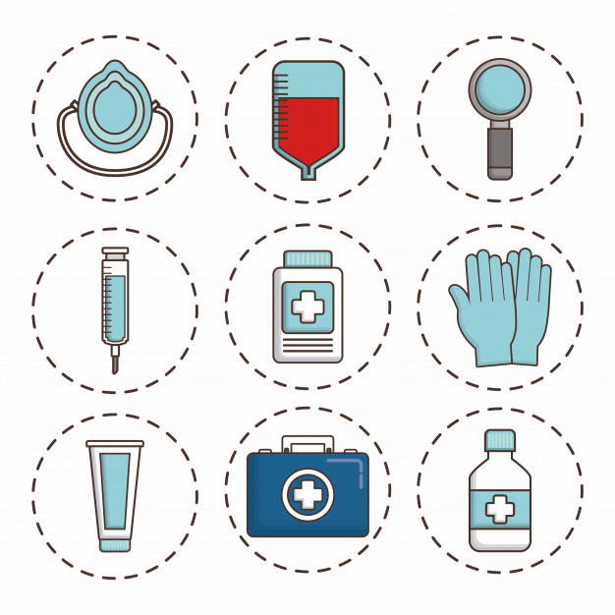

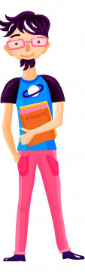
2. Problem
1.36 Million
LCH
https://www.rivm.nl/en/contact/doing-business-with-rivm/offers-for-equipment-to-fight-corona-crisis
Notes:
1.36 million people work in healthcare in the Netherlands, and now, many of these people are on the frontline, battling the crisis.
The current pandemic crisis is resulting in a shortage of medical equipment.

Slide 6



I can
help!
LCH
a.abbasi1@tue.nl
Notes:
In the Netherlands, the Landelijk Consortium Hulpmiddelen (LCH) is working on this day and night.
They receive a lot of e-mails from medical and non-medical manufacturers willing to help. How can we handle these and assure the quality of these new products?
How can we make this process faster?

Slide 7

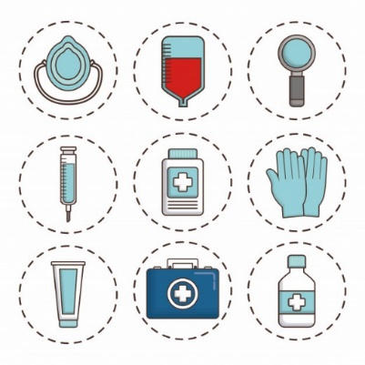
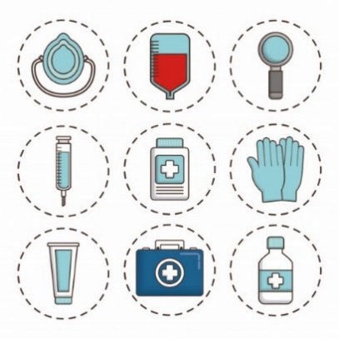
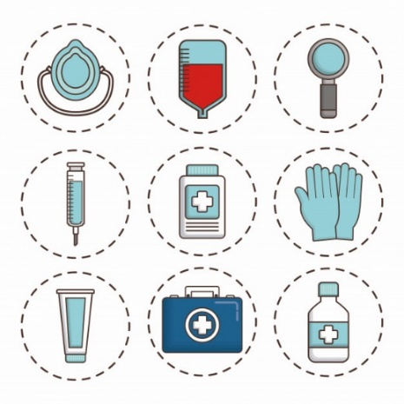
3. Current Solution
Email tenders on middelencorona@nfu.nl.
Inspection prior to procurement.
Fully legible (uncensored) illustrations.
Fully legible (uncensored) certificates.
The quantities and physical location of the goods.
https://www.rivm.nl/en/contact/doing-business-with-rivm/offers-for-equipment-to-fight-corona-crisis
a.abbasi1@tue.nl

Slide 8
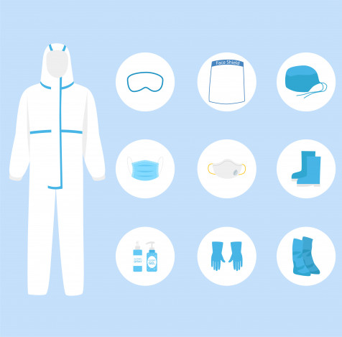

4. Demand
FFP1, FFP2, FFP3 masks
Protective coats
Splash resistant safety spectacles
Aprons
Surgical masks (type IIR)
Examination gloves
Diagnostic tests materials
Ventilation equipment.
LCH
https://www.rivm.nl/en/contact/doing-business-with-rivm/offers-for-equipment-to-fight-corona-crisis

Slide 9
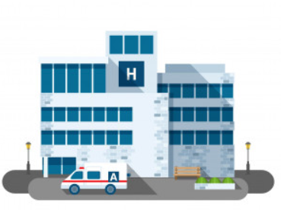

5. Our Solution
LCH
DEMAND
OFFERS
a.abbasi1@tue.nl
SOTI
Notes:
Here is Soti. Soti is an e-platform that builds upon what is already available. It helps the LCH bridge the gap between healthcare institutions and manufacturers. Soti shows the demands from the hospitals, offers from manufacturers, and allows LCH to place orders.

Slide 10
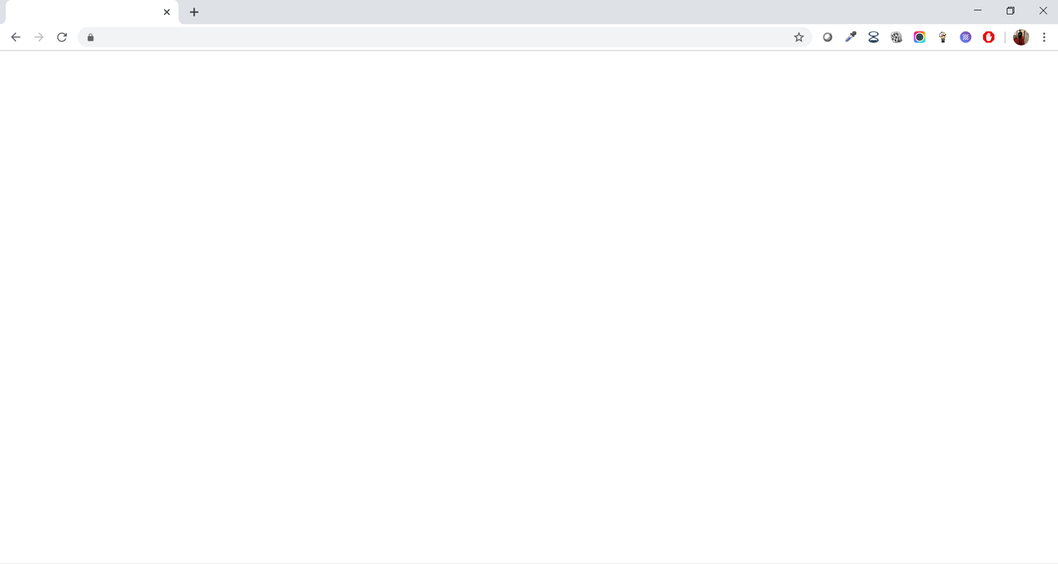
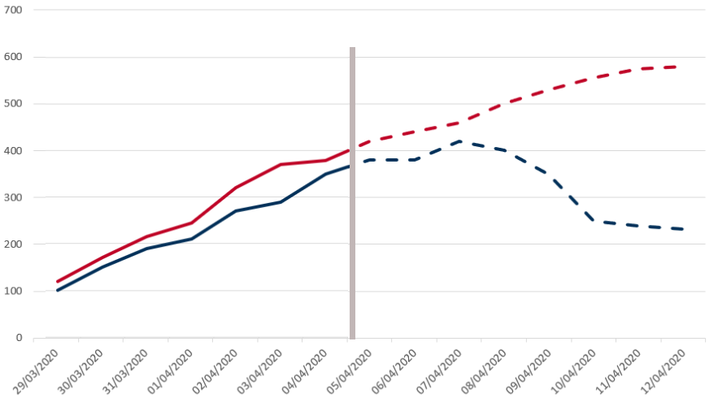
Hospital A
Number of masks needed
Hospital B
DEMAND
Past
a.abbasi1@tue.nl
Notes:
Let’s look at the demand first. Soti incorporates the power of Machine Learning. How? Right now, hospitals register how much equipment they use every day in the PPE Corona App.

Slide 11
Hospital A
Number of masks needed
Hospital B
DEMAND
Past
Future
a.abbasi1@tue.nl
Notes:
But if we know, the required equipment for hospitals in the coming week, or next two weeks, we can send alerts if there is space to move equipment from hospital A to hospital B, or if it is necessary to place new orders.

Slide 12
Hospital A
Number of masks needed
Hospital B
DEMAND
Past
Future
a.abbasi1@tue.nl
Notes:
Having a machine learning model to predict demand allows the LCH to intervene at an earlier stage. We built a prediction model based on number of cases. To predict the shortage of equipment on provincial level. If we are able to get data of PPE demands from GGD or RIVM we can deploy the model directly on the equipment data.

Slide 13

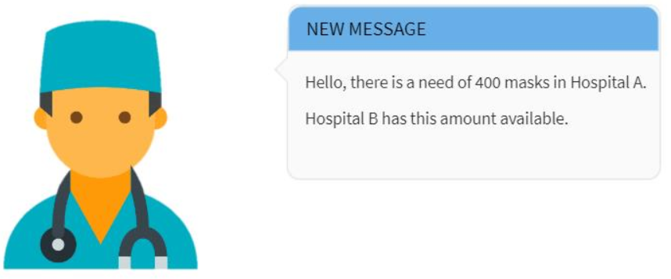
Hospital A
Number of masks needed
Hospital B
DEMAND
Past
Future
a.abbasi1@tue.nl
Notes:
Every time there is a need of equipment either local hospital inventories can be checked or directly manufacturers can be approached. Right now we are using Xgboost as a prediction algorithm and accuracy is around 76 % for now. We are predicting the shortage of equipment regions for now based on the number of cases in the provinces. The other features we are using are demographics(population density, temperature(wind speed, humidity, temperature),

Slide 14

OFFERS
a.abbasi1@tue.nl
Notes:
Let’s now look at the offers. We want to enable everyone, medical and non-medical manufacturers to offer help when the demand is high. That’s why everyone can reach out on Soti, and mention which products they can produce. After registration, the quality of their products is checked.

Slide 15




E- Tender
E- Tender
LCH
E- Tender
OFFERS
https://www.rivm.nl/en/contact/doing-business-with-rivm
Notes:
Manufacturers can upload their online tenders along with the certificates and images of illustrations , LCH compares the submitted offers and order the equipment immediately based on the demand and costs that are suitable to them.

Slide 16
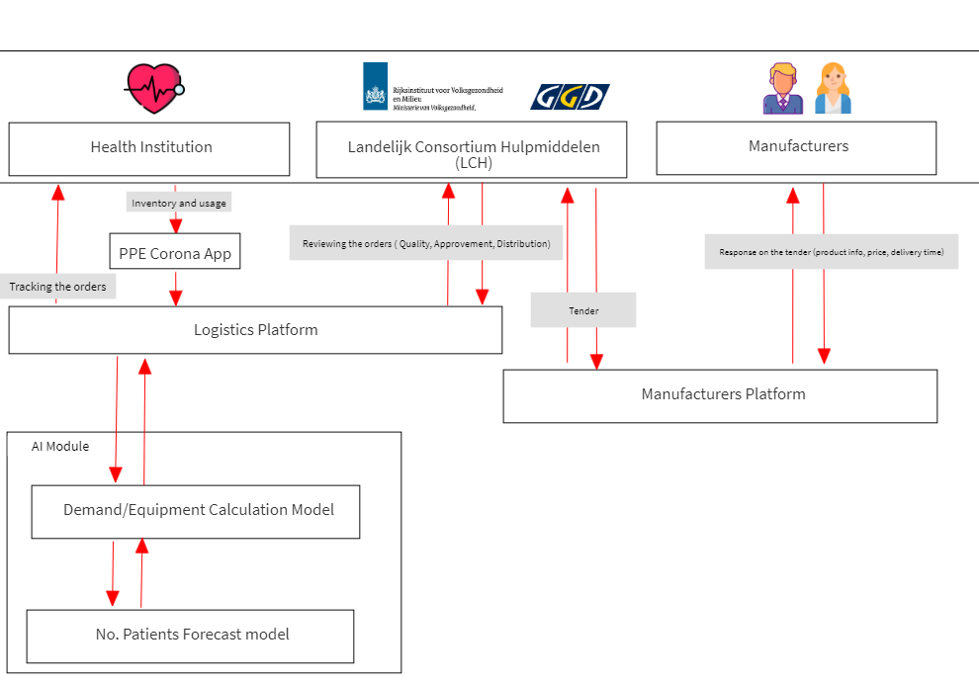
6. Architecture
Notes:
Soti architecture

Slide 17
7. Conclusion
Early intervention through predictive model
Involves small businesses
Integrates three main parties and thousands of people
a.abbasi1@tue.nl
Notes:
So why Soti? Through our Data Science capabilities, Soti allows for early intervention through our implemented predictive model, it allows big businesses as well as small businesses to come to play, it integrates three main parties (LCH, Healthcare Institutions and Manufactures) and thousands of people.

Slide 18

SOTI connects them all
LCH
a.abbasi1@tue.nl

Slide 19
7. Limitations
Predictive model based on number of cases
Data of shortage material not available
Doesn't takes into account the profitability opportunities for manufactures
Model results still updating
a.abbasi1@tue.nl

Slide 20
Thankyou!
Questions
SOTI video pitch: https://www.youtube.com/watch?v=W3ZyjMwOD1A
Email: a.abbasi1@tue.nl
LinkedIn: https://www.linkedin.com/in/aneesa-abbasi/
JADS: https://www.jads.nl/

